Slide 1
Imputation for Provisional COVID-19 Deaths in 2020

Slide 2
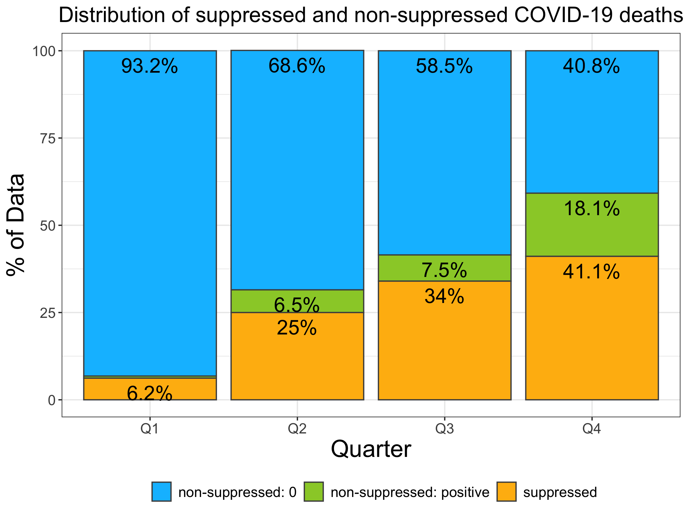
Why imputation?
County-level COVID-19 death counts from 1 to 9 were suppressed
The percent of data with suppressed COVID-19 death counts increased from Q1 to Q4
Could bias the estimates of the years of potential life loss (YPLL) due to COVID-19
Non-suppressed data: 0 COVID-19 death reported
Non-suppressed data: ≥10 COVID-19 deaths reported
Suppressed data: 1-9 COVID-19 deaths reported
Notes:
The reason why we explored imputation method for this study is because the county-level COVID-19 deaths between 1 and 9 were suppressed in the dataset.
This figure shows the distribution of suppressed and non-suppressed COVID-19 deaths in the dataset. Blue represents the % of data with ZERO COVID-19 deaths. Green represents the % of data with 10 or more COVID-19 deaths, which are not suppressed. Gold represents the % of suppressed data, which are 1-9 COVID-19 deaths.
We show this distribution by quarter. The percent of data with suppressed COVID-19 death counts increased from 6.2% in Q1 to 41% in Q4.
In quarter 4, the % of suppressed data is non-ignorable. We were concerned that the suppressed data could bias the estimates of the years of potential life loss due to COVID-19 in 2020.

Slide 3
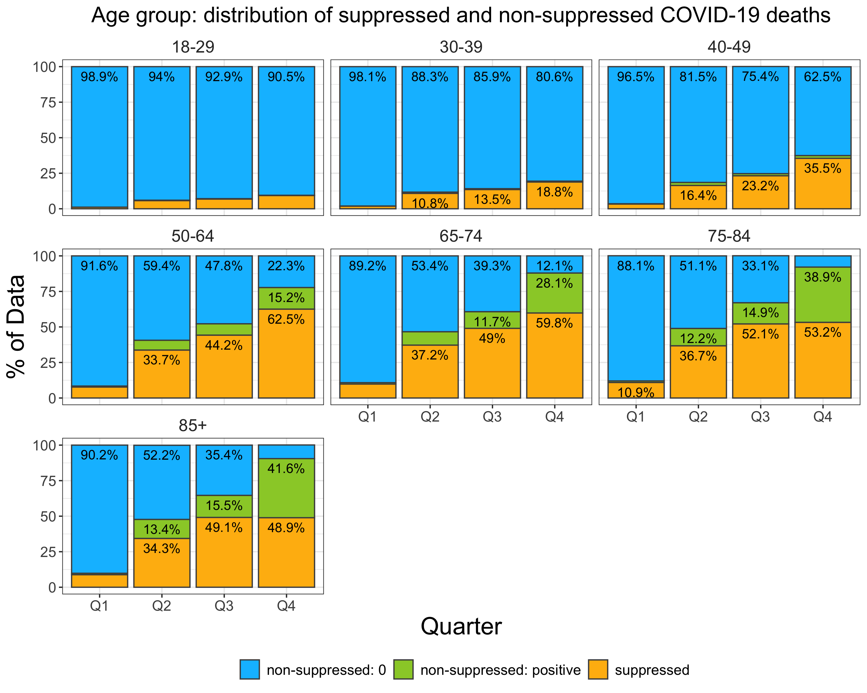
Data type by age group
More suppressed data among older age groups
More zeros among younger age groups (18-29, 30-39, 40-49)
Non-suppressed data: 0 COVID-19 death reported
Non-suppressed data: ≥10 COVID-19 deaths reported
Suppressed data: 1-9 COVID-19 deaths reported
Notes:
In addition to the quarters, age groups play a role in the pattern of suppressed data.
We can see that there were more suppressed data among older age groups than younger age groups.
For example, in quarter 4, there are nearly 60% of suppressed data among age 65-74, but only 19% of suppressed data among age 30-39.

Slide 4
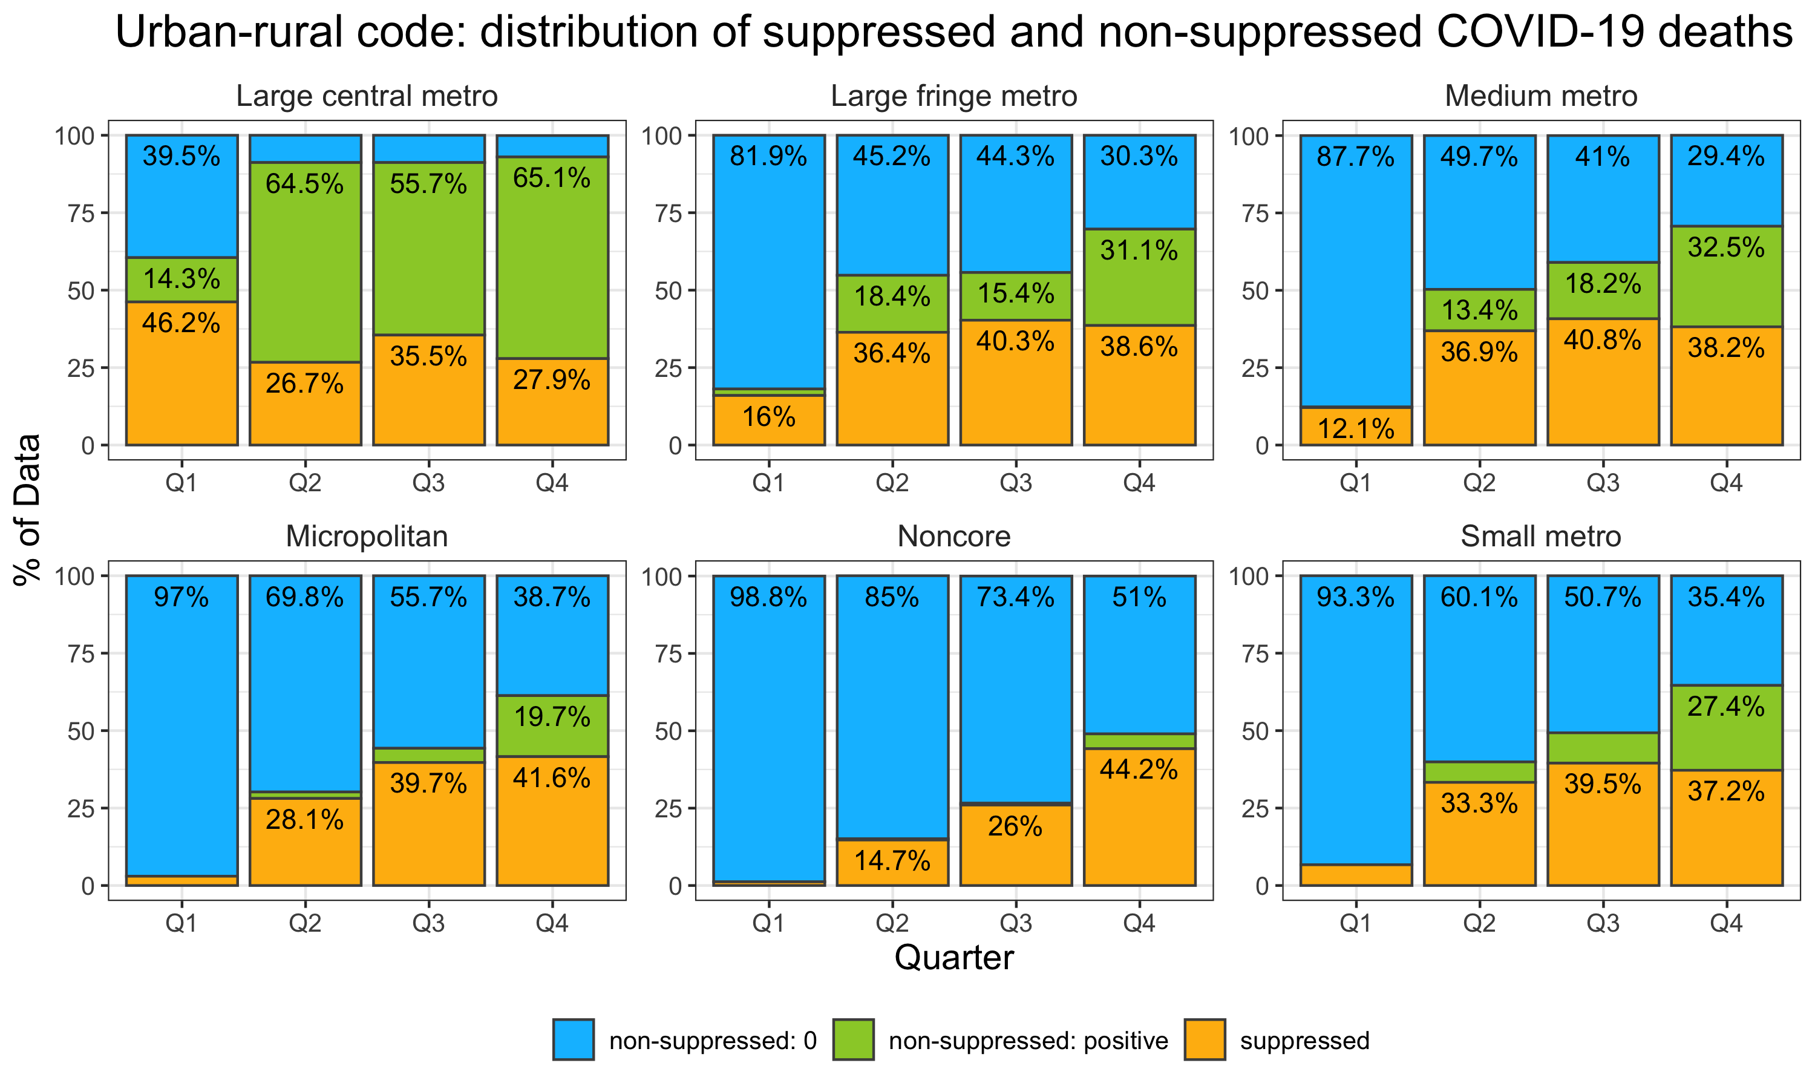
Data type by county type (urban/rural)
The pattern of counties with zeros and suppressed data varied with the types of counties
Large central metro had a very different pattern than the other types of counties
Large fringe, medium, and small metro had a similar pattern of zeros and suppressed data
Non-suppressed data: 0 COVID-19 death reported
Non-suppressed data: ≥10 COVID-19 deaths reported
Suppressed data: 1-9 COVID-19 deaths reported
Notes:
The type of county also play a role in the pattern of the suppressed data.
We can see that the pattern of suppressed data were different among county types.
Large central metro had a very different pattern than the other county types. In quarter 1, large central metro already had a huge proportion of suppressed data compared to other county types.
Metro counties such as large fringe, medium and small metro had a similar pattern of zeros and suppressed data.
Micropolitan and noncore had a similar pattern.
Because of these reasons, we are considering imputation methods that account for age groups and county type to impute the suppressed COVID deaths

Slide 5
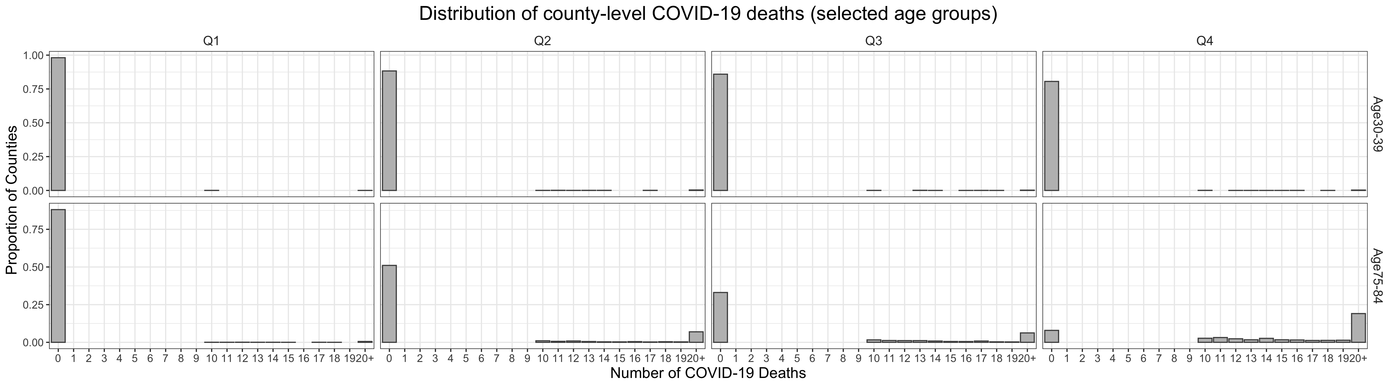
Distribution of COVID-19 deaths
Note: Number of COVID-19 deaths was top-coded at 20. All death counts ≥ 20 were collapsed into “20+”
A large mass of zero COVID-19 deaths
In early pandemic (e.g., Q1 and Q2)
Among younger age groups
Notes:
Before we started talking about the imputation method, we need to understand the distribution of county-level COVID-19 deaths
This figure shows the distribution of the COVID-19 deaths by quarters among all counties
The x-axis is the number of COVID-19 deaths. We top-coded the deaths at 20. All the death counts >= 20 were collapsed into 20+
The y-axis is the proportion of counties.
We show two age groups for example. The top panel is the distribution for age 30-39, and the bottom is for age 75-84.
We see that there is a large mass of zero COVID-19 deaths for age 30-39 across all quarters. For age 75-84, there is a large mass of zero COVID-19 deaths in quarter 1 through quarter 3. In quarter 4, much fewer counties reported 0 COVID death among age 75-84.

Slide 6
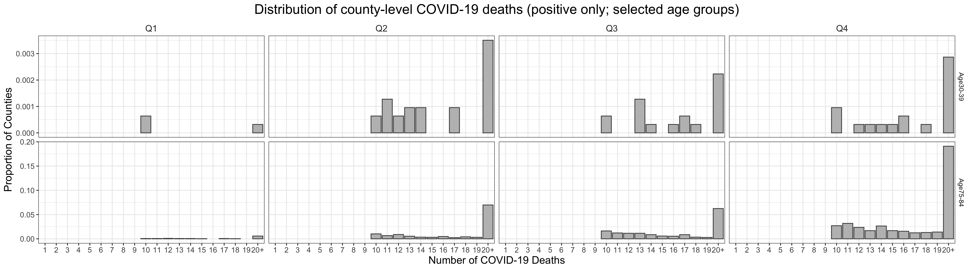
Distribution of COVID-19 deaths
Note: Number of COVID-19 deaths was top-coded at 20. All death counts ≥ 20 were collapsed into “20+”
A large mass of zero COVID-19 deaths among counties
Positive death counts follow a right-skewed distribution
The largest value is 1,505 COVID-19 deaths among the population aged 75-84 in Queens County, NY in quarter 2
Notes:
In this figure, we focus only on the distribution of counties reported positive COVID-19 deaths.
You would see a big proportion of counties reported at least 20 COVID deaths. This indicates a potentially right-skewed distribution among the counties reported positive deaths.
Because counties reporting 1-9 deaths were suppressed, there are no bars for deaths ranging from 1 to 9.

Slide 7
Distribution of COVID-19 deaths
The suppressed COVID-19 death counts have to follow some hypothetical distribution
Have a large mass of zero
Right-skewed distribution
Other determinants
Temporal trend
Age group
Type of county (urban/rural)
Population size
State trend
Distribution of county-level COVID-19 deaths (positive only): Age 75-84; Quarter 4
3
?
Proportion of Counties
2
1
Number of COVID-19 Deaths
Note: Number of COVID-19 deaths was top-coded at 20.
All death counts ≥ 20 were collapsed into “20+”
Notes:
Here we show the distribution of county-level COVID-19 deaths for age 75-84 in quarter 4 for example.
We do not know the distribution of the suppressed data. How can we impute the suppressed data?
There are some hypothetical distribution we can draw upon
(Click) For example, we can sample from a uniform distribution from 1 to 9.
(Click) We can assume a gamma distribution with a certain parameterization that might follow this shape
(Click) or another gamma distribution with a different parameterization following a different shape
Of course, there are more than three hypothetical distributions.
We want to find a plausible distribution that can be integrated into the distribution of county-level COVID-19 deaths that we saw in the previous slides.
1. The distribution has a large mass of zero.
2. The distribution is possibly right-skewed.
3. There are other determinants.
Temporal trend (evolution of the pandemic from quarter to quarter)
Heterogeneity due to age group, county type, population size, and state trend etc.

Slide 8
Methods
Population:
3,138 counties (removed 2 counties due to no population estimates)
Data:
AH Provisional COVID-19 Deaths by Quarter, County and Age for 2020
American Community Survey 5-Year Estimates
Methods: Bayesian multilevel gamma hurdle model
Estimate the probability of having 0 deaths and positive deaths separately
Assume a right-skewed distribution among the positive deaths
3 levels: time trend (quarters), county level, and state level
DC and NYC are accounted as state level in the analysis
Factors included: age groups, type of county, population size
Aggregate annual COVID-19 deaths by age group at state level is part of likelihood
Notes:
We model the suppressed data among the 3138 counties by quarters
We used a Bayesian multilevel gamma hurdle model to model the suppressed data.
Hurdle model allows us to estimate the probability of having 0 deaths and positive deaths, separately.
Gamma distribution is flexible to model a right-skewed distribution among the positive deaths
We considered three level of the model because the death data are correlated in some way. first level is the time trend, the second is the county, and the third level is the state.
The other control variables include age groups, type of county, and population size

Slide 9
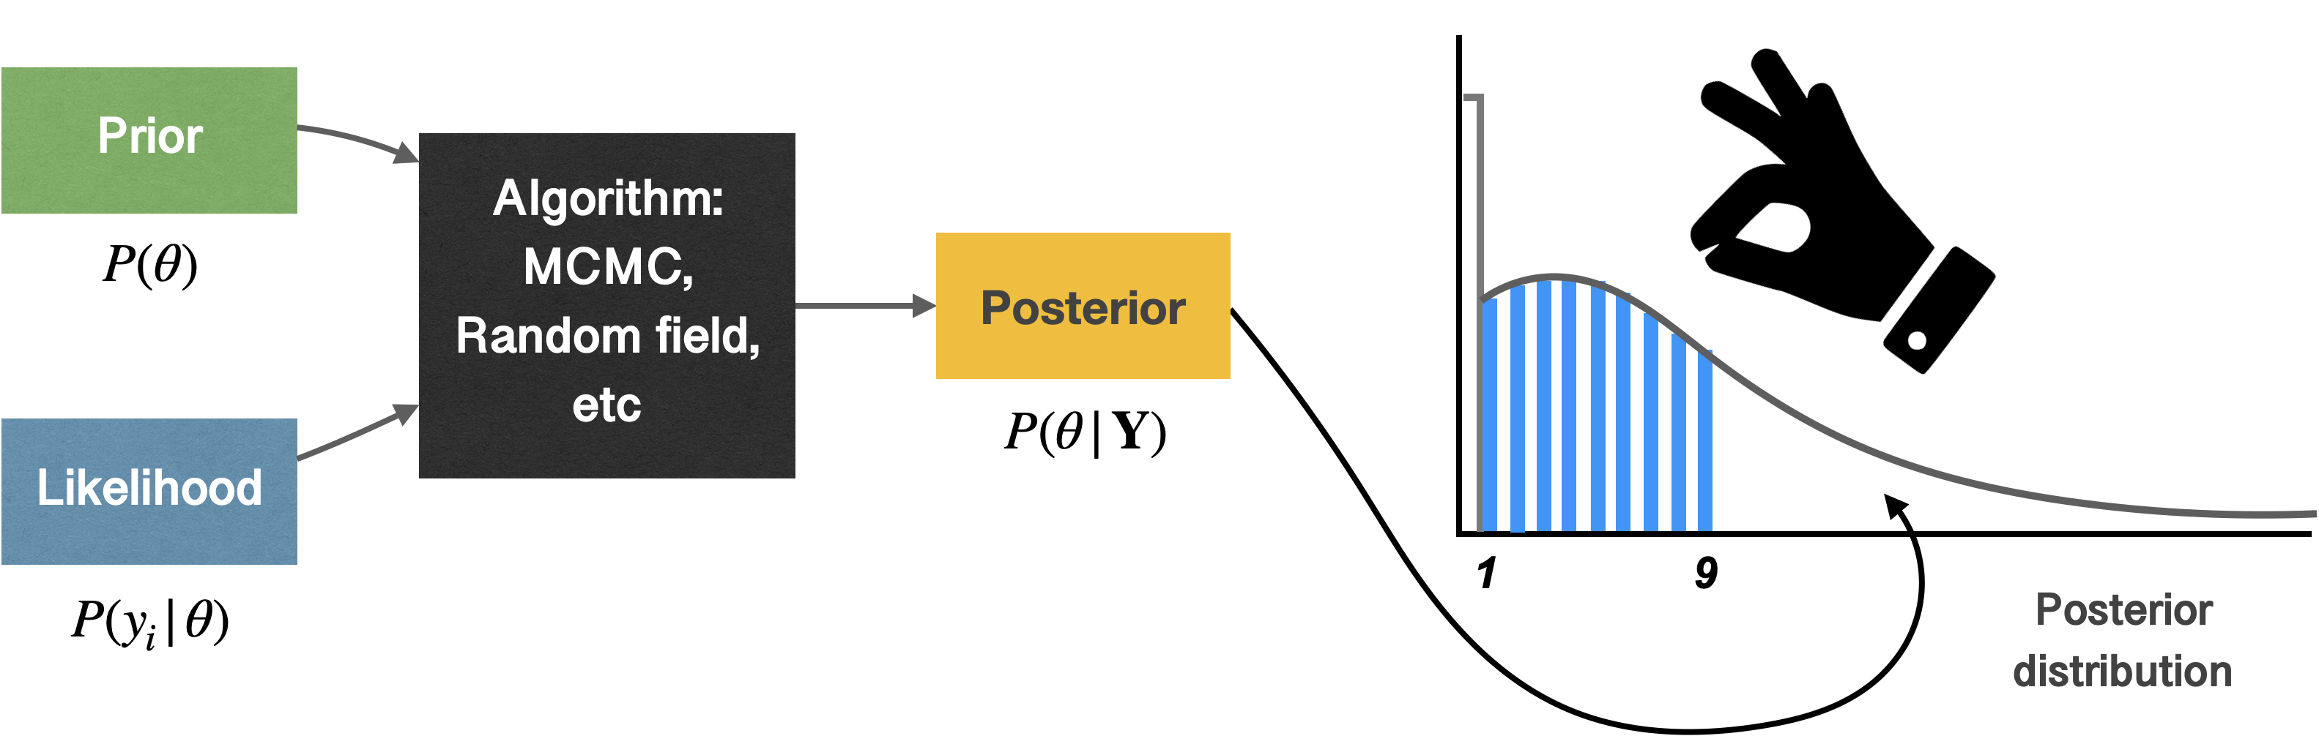
Why Bayesian method?
If we can reconstruct the posterior distribution, we can get the credible values for the suppressed data by sampling from the posterior distribution.
In the next two slides, we show whether the Bayesian method creates a plausible distribution
Notes:
Why did we pick Bayesian method?
In Bayesian framework, there are three important components for bayesian modeling: a prior distribution for each parameter that we plan to estimate (which is our belief of the parameters). In our case, we can treat the suppressed/missing data as the parameters that have to be estimated.
The second component is the likelihood informed by the data, and the third component is the algorithm.
These three components (Click) give us a posterior distribution from which we can draw random samples
(Click) So, if we can reconstruct the posterior distribution, we can get the credible values for the suppressed data by sampling from the posterior distribution.
In the next two slides, we show whether the Bayesian method creates a plausible distribution.

Slide 10
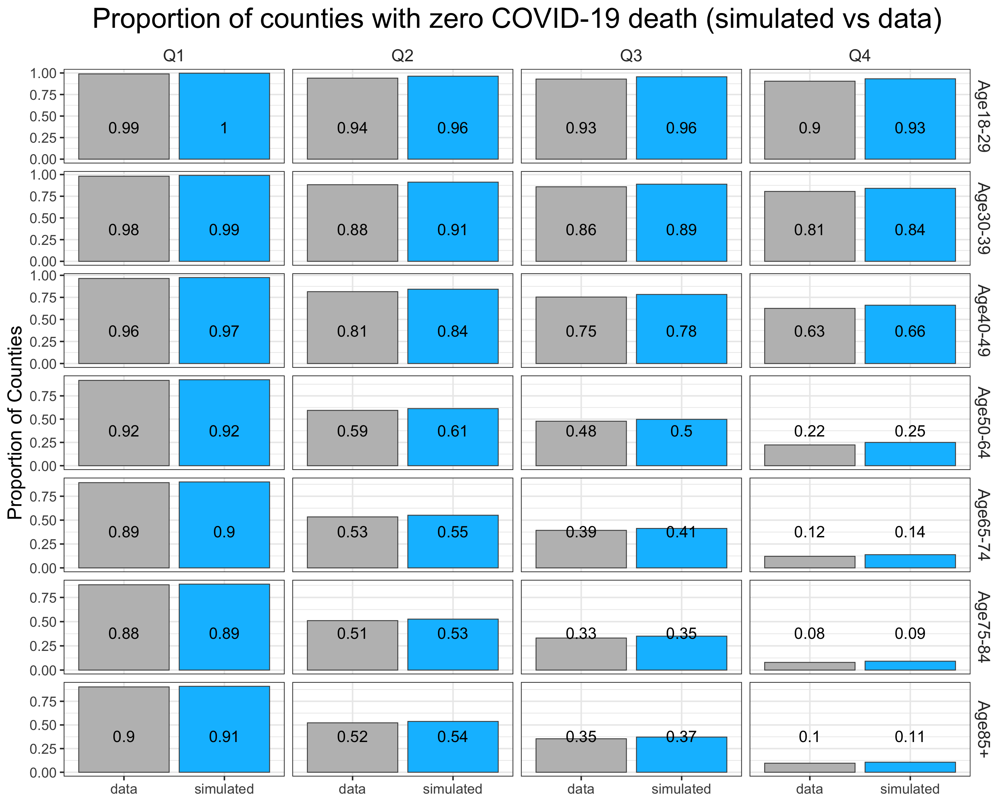
Simulated data vs observed data
This is to check whether the bayesian method created a plausible distribution
The proportions of counties with zero COVID-19 deaths are similar between the simulation from the posterior distribution and observed data
Notes:
In this figure, we only focus on the proportion of counties with zero COVID-19 death from the simulation based on the posterior distribution compared to the observed zero deaths among counties.
The proportion was organized by age group and quarter.
The gray bars are the proportion of counties reported zero COVID-19 deaths calculated from the observed data.
The blue bars are the simulated proportion from the posterior distribution.
For age 30-39 in quarter 4, 81% of the counties reported 0 COVID-19 death in the data. Using the simulation, we got the same 81% of counties that reported 0 COVID-19 deaths.
I would say that the prediction of the zero COVID-19 deaths from the model reflects the data very well.

Slide 11
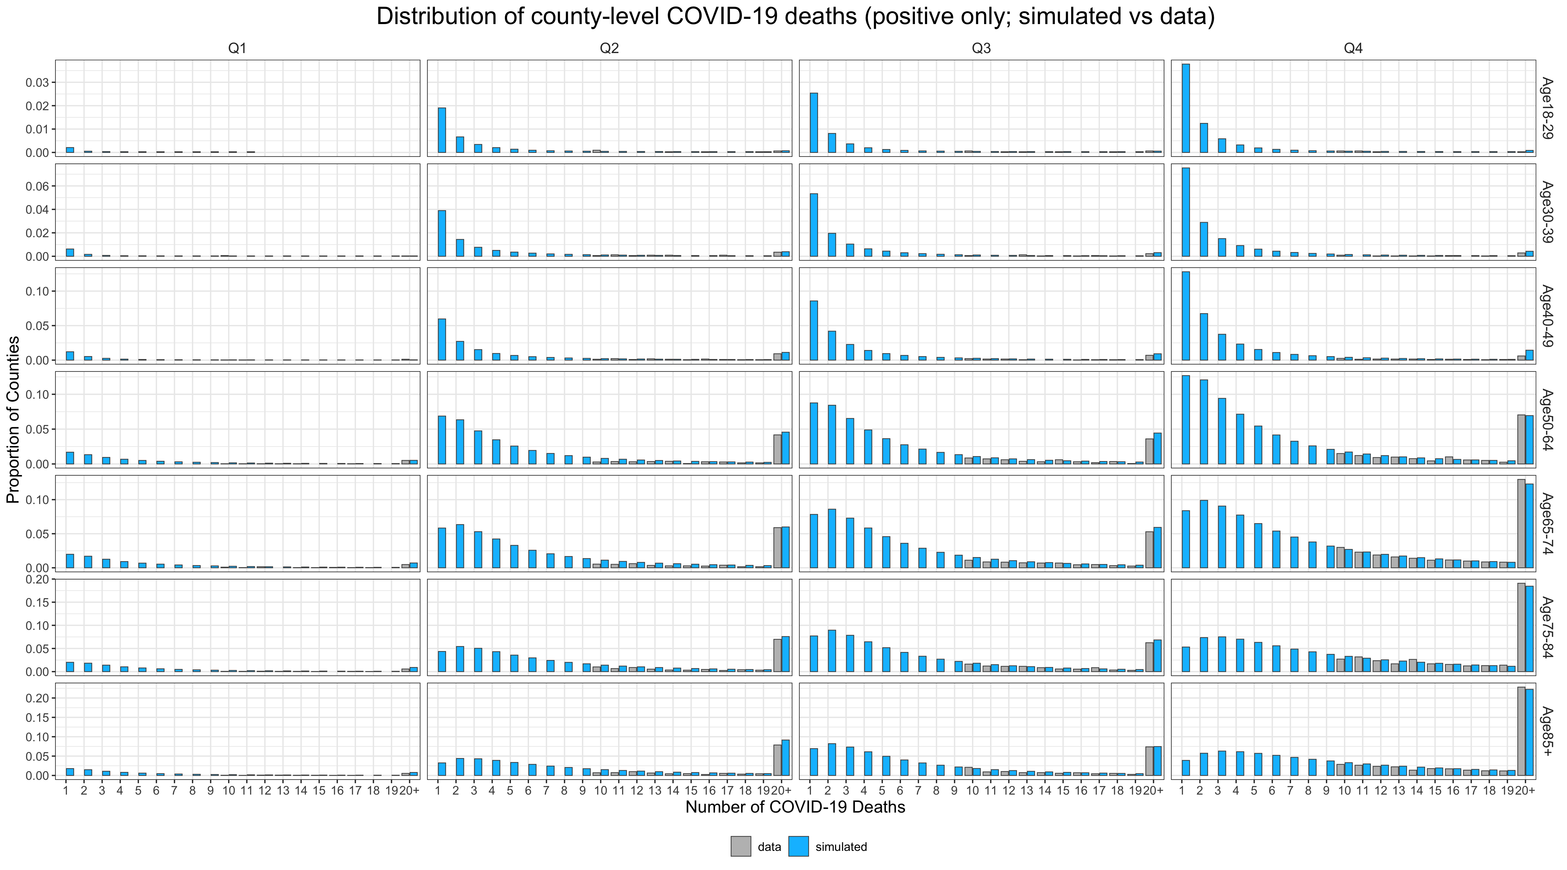
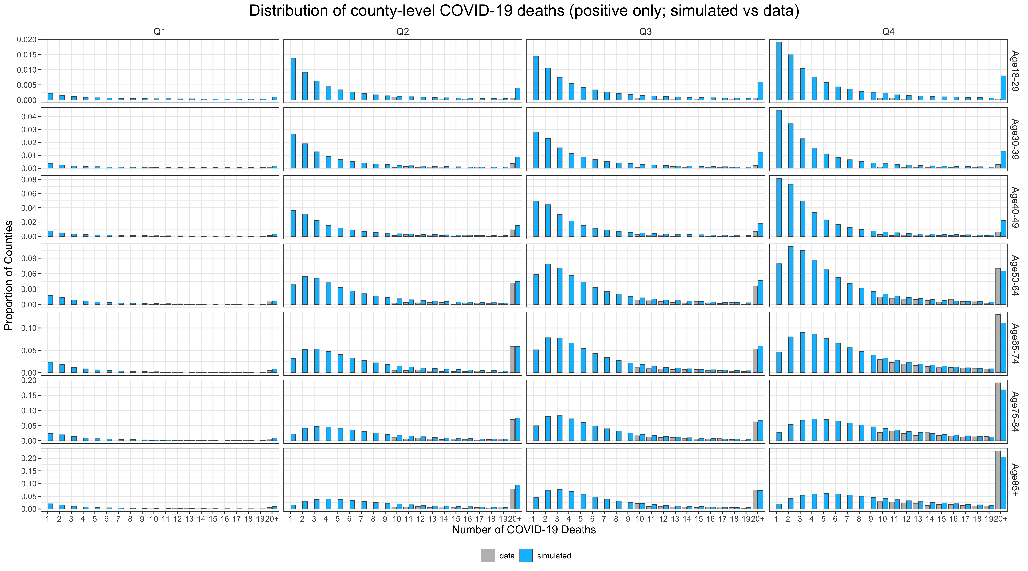
Simulated data vs observed data
Observed data
Simulated data
Notes:
This figure shows the distribution of counties reporting positive COVID-19 deaths by age group and quarter.
The gray bars are the proportion of counties reporting 10 or more COVID-19 deaths and the blue bars are the simulated proportion of positive COVID-19 deaths from the posterior distribution.
For age 75-84 in quarter 4, we can see that the distribution of among 10 or more deaths looks similar between the simulation and the observed data. For the proportion of counties reporting 20 or more deaths, the simulation from the Bayesian method is slightly underestimated compared to the observed data. There are no gray bars among 1-9 deaths because data suppression.
Overall the distributions from the Bayesian method look reasonable but there seems to be a slight overestimation across age groups, especially among the younger age groups.
This might be because that there was not a lot of information to draw inference among the younger age groups due to smaller number of deaths observed.
I just want to remind everyone that these two slides are to show that the posterior distribution from the Bayesian method reflects what we observed in the county-level data.

Slide 12
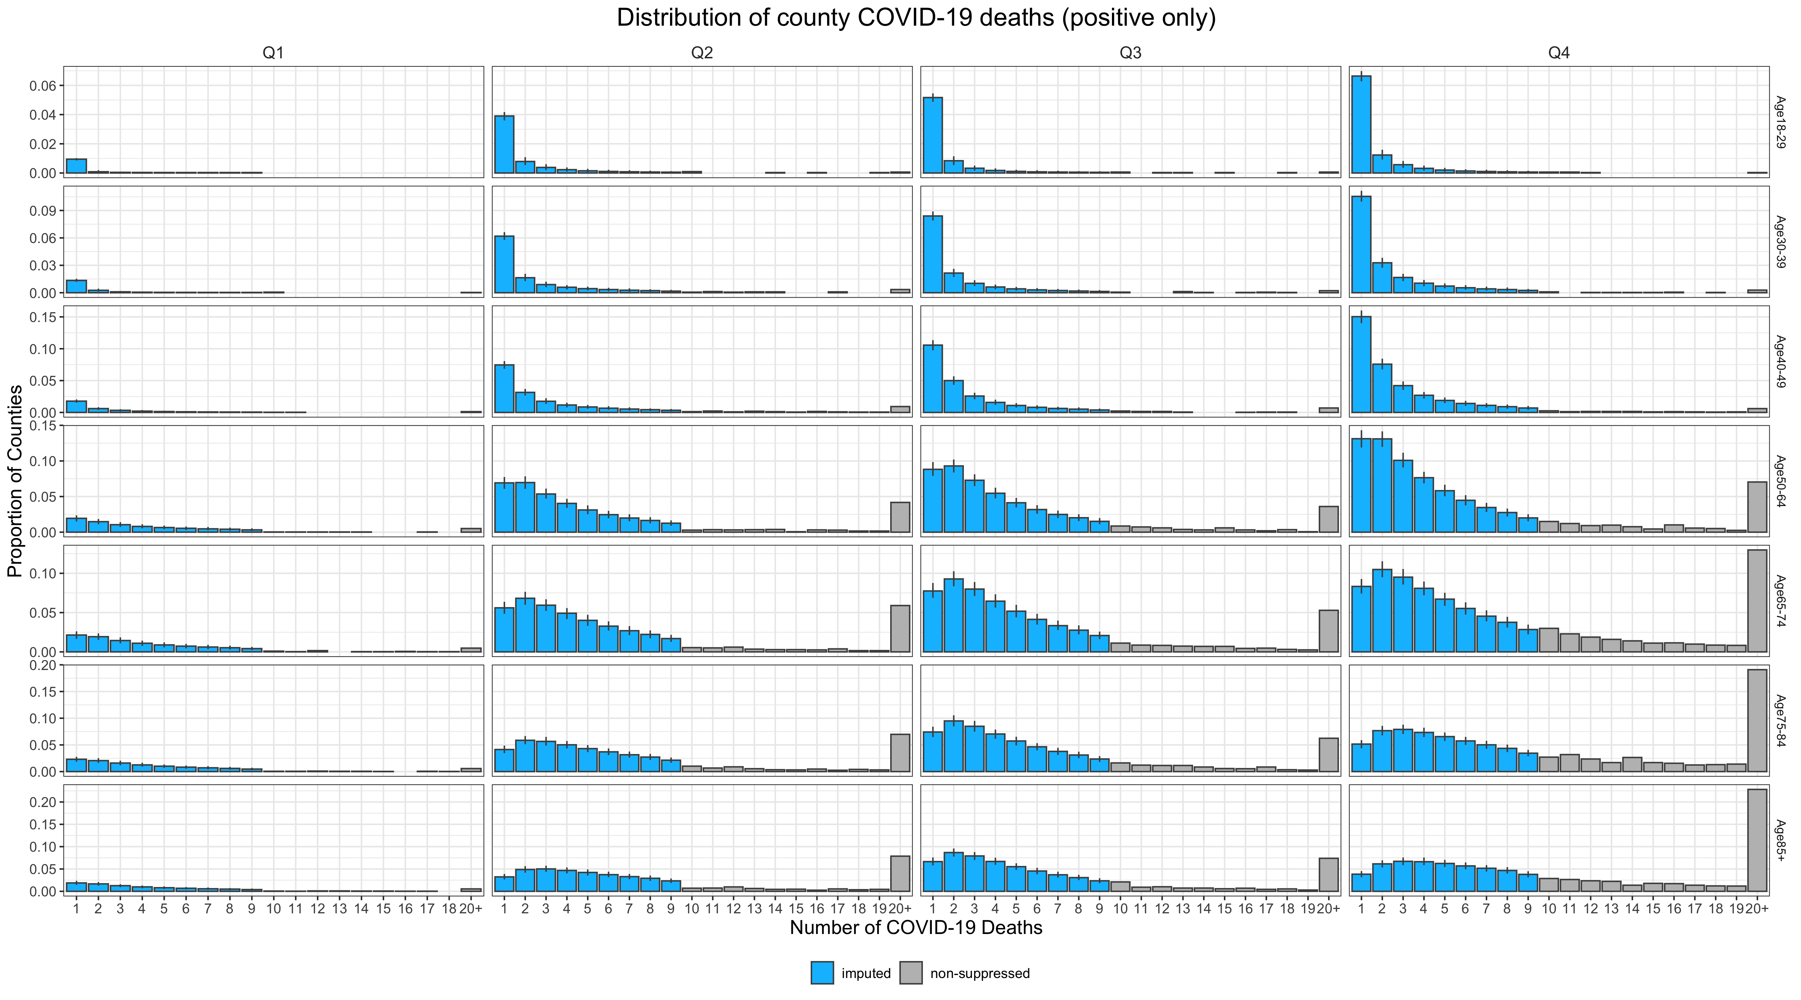
Combine imputed and observed data
Observed data
Imputed data
Notes:
Here we piece together the imputation for the suppressed data and the observed data. The figure shows the distribution by age group and quarter.
We ignore 0 death here since it doesn’t contribute to the calculation of YPLL.
The gray bars are the observed data. The blue bars are the imputed data drawn from the posterior distribution. The vertical bars represent the uncertainty bounds.
Let’s look into age 65-74 in quarter 4, you could see that the mode of the imputed deaths is 3. There seems a smooth declining shape after the mode but a small dip at 9 deaths.
In general, in earlier quarters and younger age groups, the mode of the imputed data is around 2. Among older age groups and later quarters, the mode might be larger at 3, or other bigger value.
I want to emphasize that the blue bars are where we impute the suppressed data. For the non-suppressed data, we will use the observed data in our final analysis

Slide 13
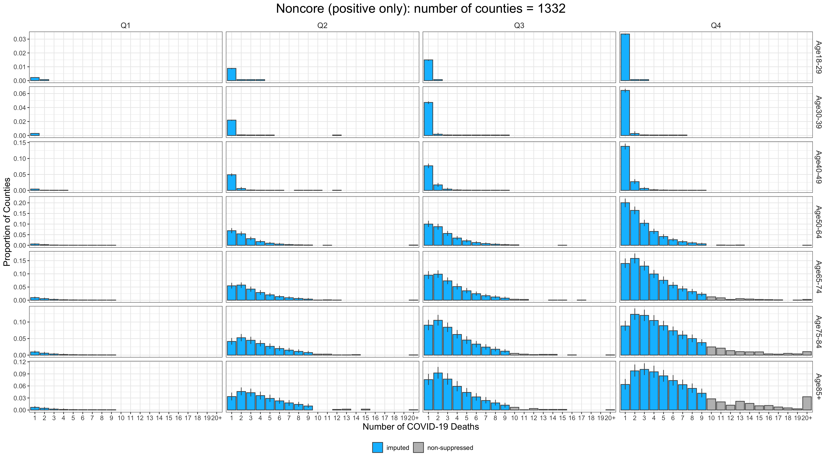
Imputation: Noncore counties
Observed data
Imputed data
Notes:
This figure shows the distributions among the noncore counties.
We choose to show this because there are 1332 noncore counties, which is about 42% of the counties.
We could see that there might be overestimation issue among the younger age groups. However, we don’t really have good information for these age groups. When counties reported deaths among younger age groups, they are likely to be in the suppressed values. So we don’t have information at the tail to inform us the suppressed distribution.

Slide 14
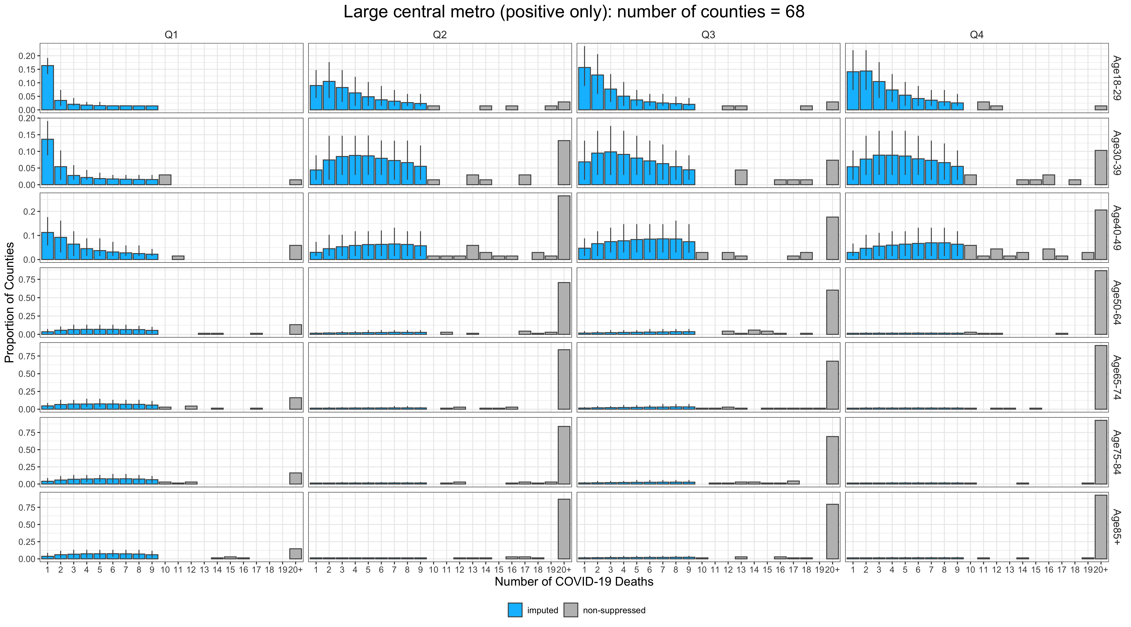
Imputation: Large central metro
Observed data
Imputed data
Notes:
Here are the distributions for the large central metro by age group and quarter.
You could see the distributions are very different than the noncore counties. In general, the modes of the suppressed data are bigger.

Slide 15
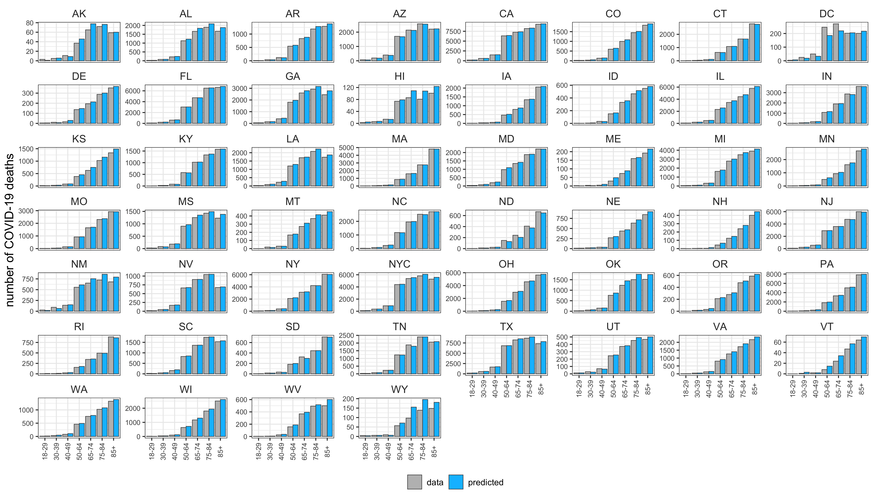
State distribution of COVID-19 deaths

Slide 16
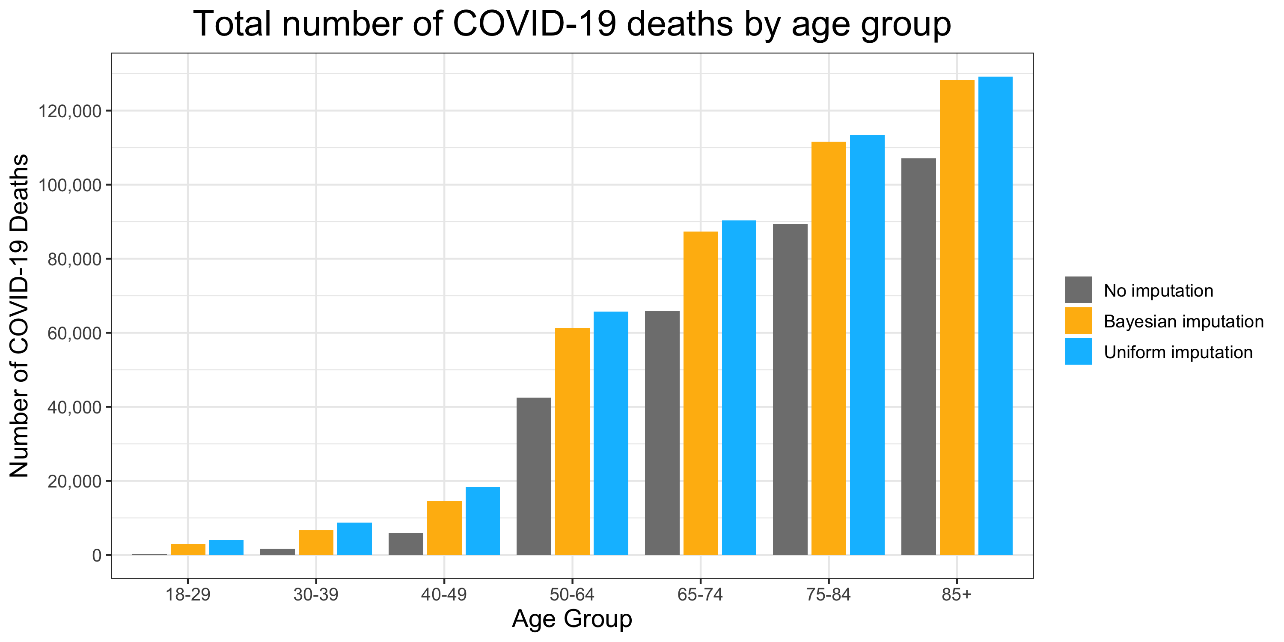
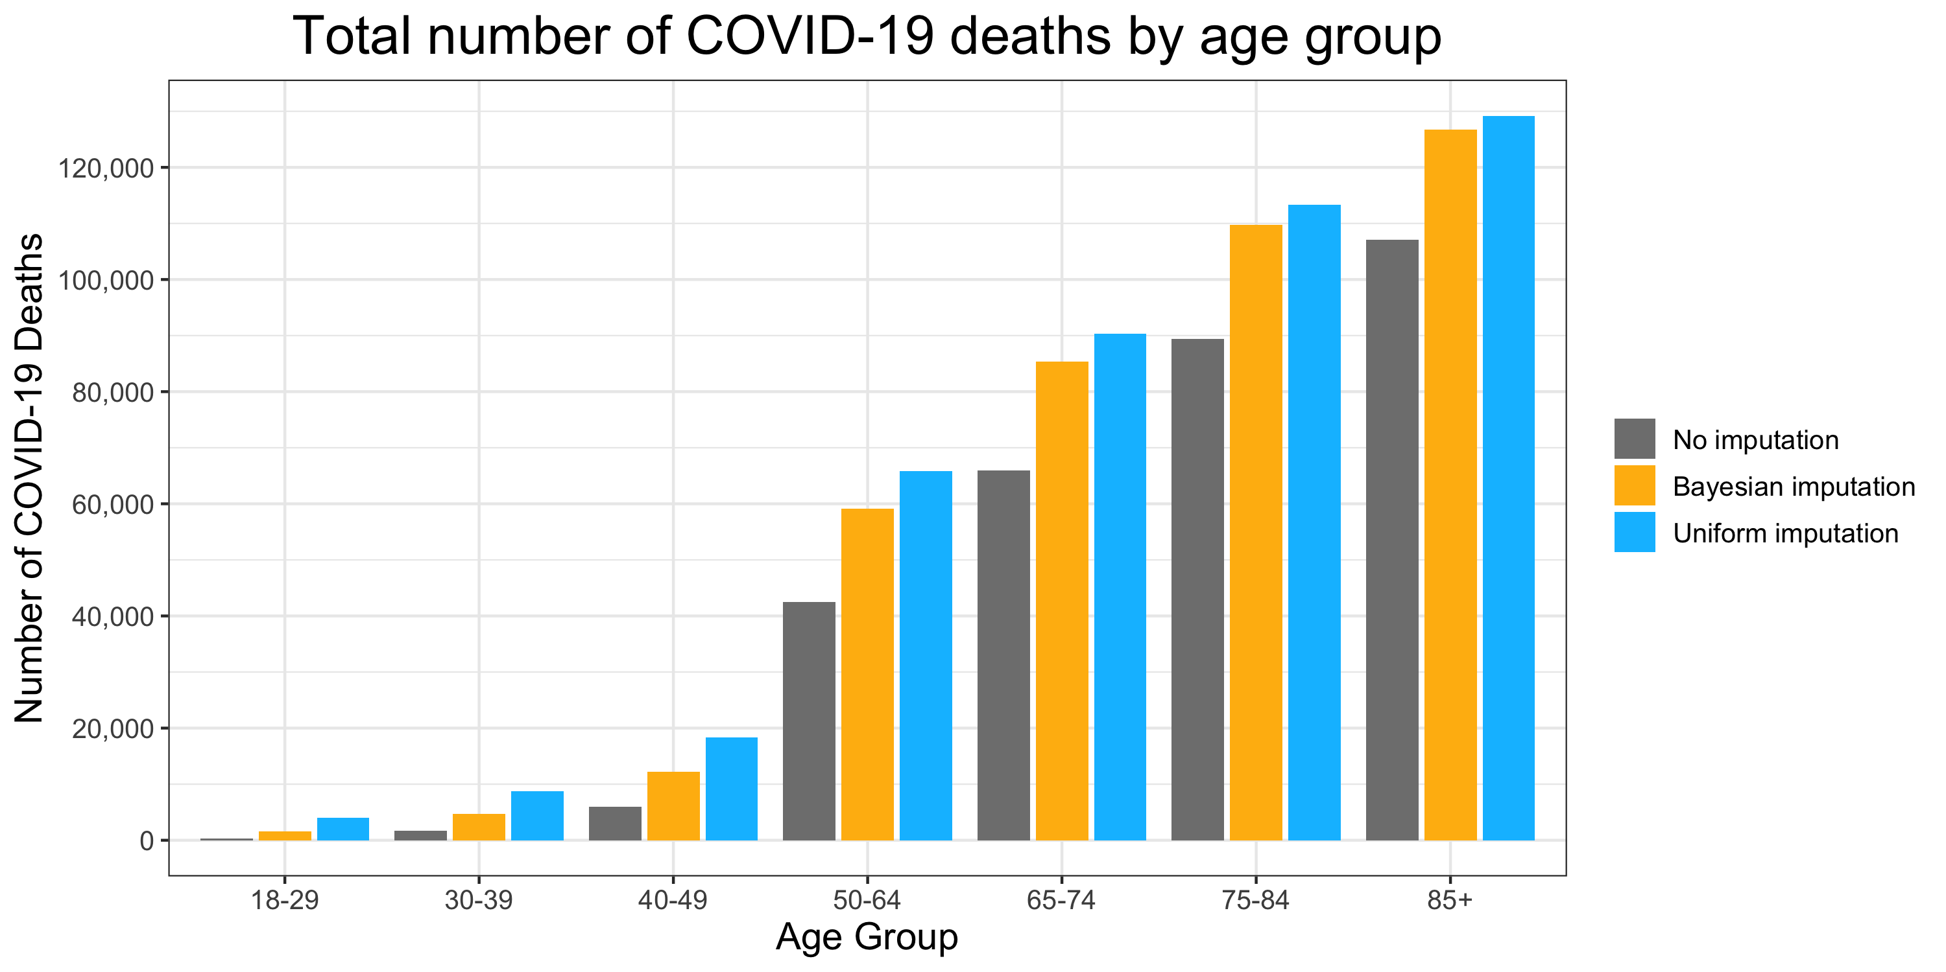
Estimated COVID-19 deaths in 2020
Uniform imputation is to random sample values between 1 and 9 from a uniform distribution
 | Estimated COVID-19 deaths in 2020
Age group | Provisional county-level data (no imputation) | Bayesian imputation (mean) | Uniform imputation (mean)
18-29 | 347 | 1,536 | 3,954
30-39 | 1,701 | 4,680 | 8,756
40-49 | 5,992 | 12,259 | 18,299
50-64 | 42,538 | 59,095 | 65,778
65-74 | 65,905 | 85,355 | 90,354
75-84 | 89,367 | 109,802 | 113,344
≥85 | 107,056 | 126,738 | 129,189
Notes:
Here we show the estimated COVID-19 deaths by age group based on three methods. The first is using the provisional county-level data without any imputation. These are the gray bars in the figure. Second is using the bayesian imputation. The gold bars. The third is using uniform imputation, which is to random sample values between 1 and 9 from a uniform distribution. We provide the uniform imputation here as an upper bound.
Overall, we can see that there is a huge difference between no imputation and bayesian imputation. Uniform imputation in general provides a higher number of deaths than Bayesian imputation.

Slide 17
New Results
Age group | No. of COVID-19 related deaths* | Provisional county-level data: no imputation | % under-estimated (no imputation) | Bayesian imputation (95% credible intervals) | % over-estimated (Bayesian imputation)
18-29 | 1,476 | 347 | 76% | 1,536 (1,485, 1,591) | 4%
30-39 | 4,272 | 1,701 | 59% | 4,680 (4,582, 4,769) | 10%
40-49 | 11,291 | 5,992 | 46% | 12,259 (12,096, 12,437) | 9%
50-64 | 56,630 | 42,538 | 24% | 59,095 (58,757, 59,418) | 4%
65-74 | 82,059 | 65,905 | 18% | 85,355 (85,020, 85,707) | 4%
75-84 | 105,964 | 89,367 | 14% | 109,802 (109,470, 110,141) | 4%
≥85 | 122,488 | 107,056 | 11% | 126,738 (126,401, 127,081) | 3%
Total | 384,180 | 312,906 | 17% | 399,465 | 4%
* Data from: https://www.cdc.gov/nchs/nvss/vsrr/covid19/index.htm
Notes:
We compared no imputation and Bayesian imputation to the number of COVID-19 related death certificates published in MMWR early this year.
The total number of COVID-19 related death certificates is about 380,000 deaths.
If there is no imputation, the provisional data without imputation underestimated the total deaths 17%. Using Bayesian imputation we overestimate the total deaths about 9%.
We also provide the difference by age group. There are bigger overestimation among the younger age groups than the older age groups.
If we have more detailed information like the distribution of the suppressed data, it can help us to reduce the bias estimates of COVID-19 deaths.

Slide 18
Appendix

Slide 19
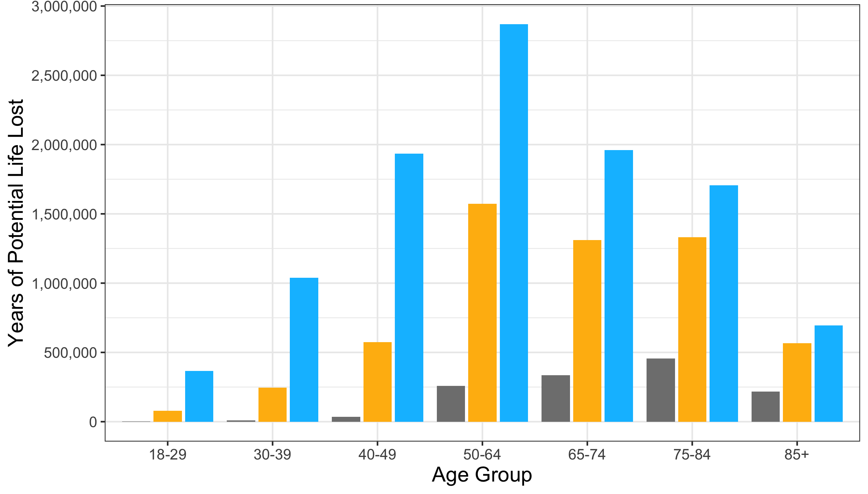
Total years of potential life loss
 | Total years of potential life loss
Age group | Provisional county-level data (no imputation) | Bayesian imputation (mean) | Uniform imputation (mean)
18-29 | 1,013 | 77,982 | 365,238
30-39 | 8,198 | 245,040 | 1,039,841
40-49 | 33,872 | 574,731 | 1,933,730
50-64 | 258,457 | 1,571,465 | 2,869,634
65-74 | 334,698 | 1,310,738 | 1,961,067
75-84 | 456,314 | 1,331,086 | 1,707,382
≥85 | 218,466 | 566,891 | 694,254

Slide 20
Mortality data
Life expectancy: https://www.cdc.gov/nchs/data/vsrr/VSRR10-508.pdf
Death data: https://www.cdc.gov/mmwr/volumes/70/wr/mm7014e1.htm
COVID-19 death certificates: https://www.cdc.gov/mmwr/volumes/70/wr/mm7014e2.htm
Total deaths: https://www.cdc.gov/nchs/nvss/vsrr/covid19/index.htm

Slide 21
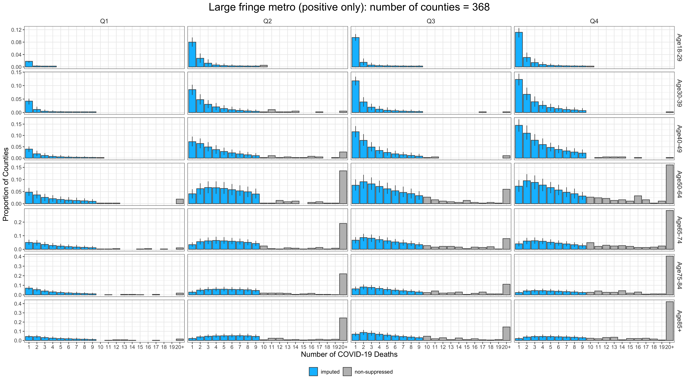
Imputation: Large fringe metro
Observed data
Imputed data

Slide 22
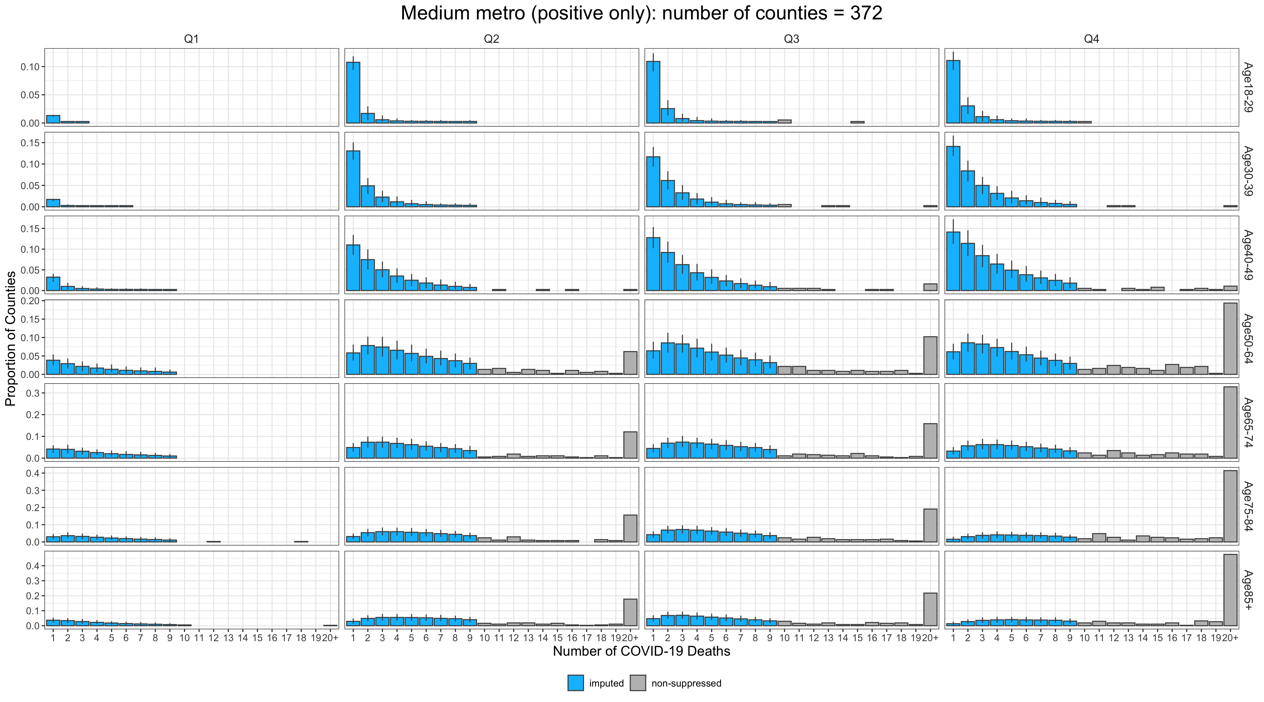
Imputation: Medium metro
Observed data
Imputed data

Slide 23
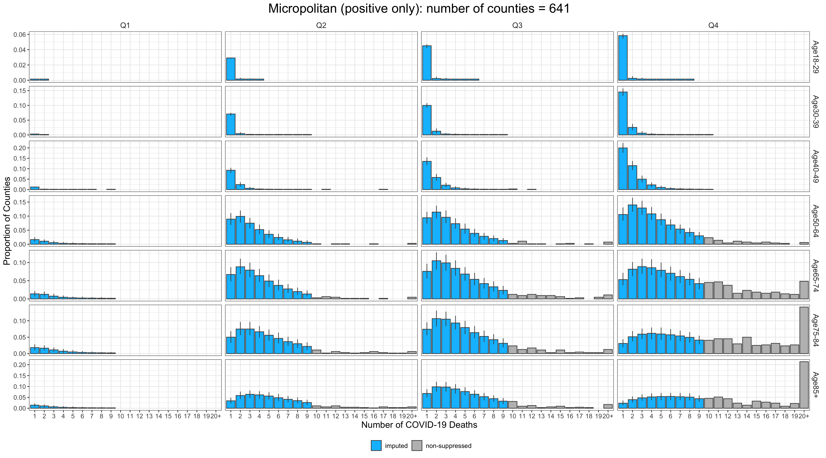
Imputation: Micropolitan
Observed data
Imputed data

Slide 24
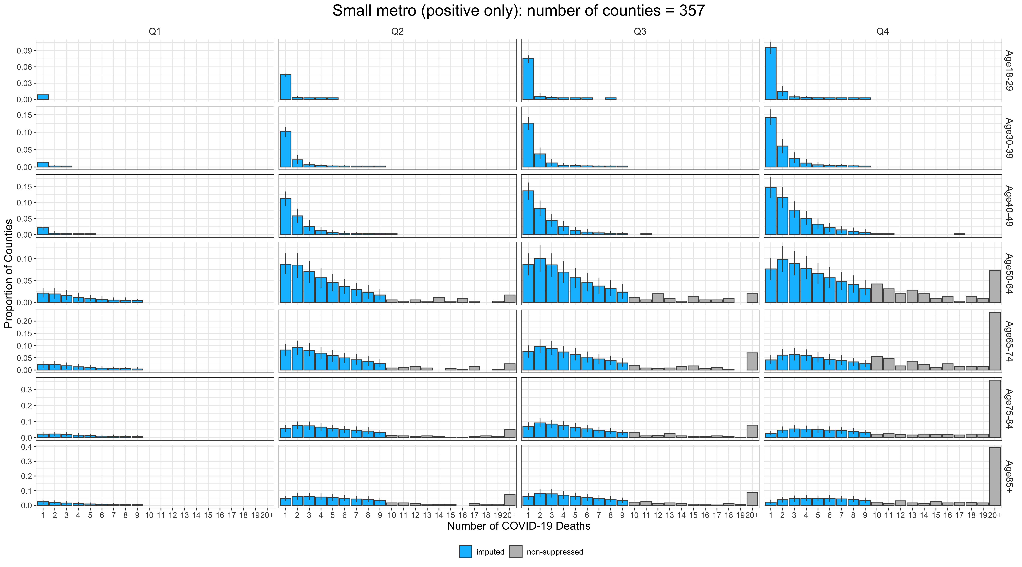
Imputation: Small metro
Observed data
Imputed data

